Slide 1

Bleeding
CHAPTER 26

Slide 2
National EMS Education Standard Competencies (1 of 3)
Trauma
Applies fundamental knowledge to provide basic emergency care and transportation based on assessment findings for an acutely injured patient.
Notes:
National EMS Education Standard Competencies
Trauma
Applies fundamental knowledge to provide basic emergency care and transportation based on assessment findings for an acutely injured patient.

Slide 3
National EMS Education Standard Competencies (2 of 3)
Bleeding
Recognition and management of
  Bleeding
Pathophysiology, assessment, and management of
  Bleeding
Notes:
National EMS Education Standard Competencies
Bleeding
Recognition and management of
• Bleeding
Pathophysiology, assessment, and management of
• Bleeding

Slide 4
National EMS Education Standard Competencies (3 of 3)
Pathophysiology
Applies fundamental knowledge of the pathophysiology of respiration and perfusion to patient assessment and management.
Notes:
National EMS Education Standard Competencies
Pathophysiology
Applies fundamental knowledge of the pathophysiology of respiration and perfusion to patient assessment and management.

Slide 5
Introduction
Important to be able to:
  Recognize bleeding.
  Understand how bleeding affects the body.
Bleeding can be external or internal.
Bleeding can cause weakness, shock, and death.
Notes:
Lecture Outline
I. Introduction
A. Recognizing bleeding and understanding how it affects the body is an important skill.
B. Bleeding can be external and obvious or internal and hidden.
Either type of bleeding is potentially dangerous and can cause weakness, shock, and death.
1. Uncontrolled bleeding is the most common cause of hypoperfusion following a traumatic injury.

Slide 6
Anatomy and Physiology of the
Cardiovascular System (1 of 2)
The cardiovascular system circulates blood to cells and tissues.
  Delivers oxygen and nutrients
  Carries away metabolic waste products
  Responsible for supplying and maintaining adequate blood flow
Notes:
Lecture Outline
II. Anatomy and Physiology of the Cardiovascular System
A. The cardiovascular system circulates blood to all the body’s cells and tissues.
1. Delivers oxygen and nutrients
2. Carries away metabolic waste products
3. Responsible for supplying and maintaining adequate blood flow

Slide 7
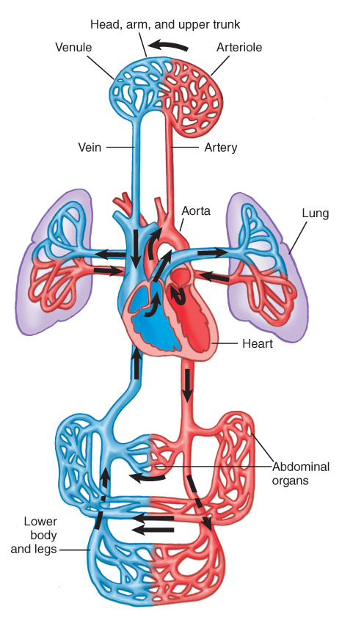
Anatomy and Physiology of the
Cardiovascular System (2 of 2)
Three parts
  Pump (heart)
  Container (blood vessels)
  Fluid (blood and body fluids)
FIGURE 26-1 The cardiovascular system includes the heart, arteries, veins, and interconnecting capillaries.
© Jones & Bartlett Learning.
Notes:
Lecture Outline
B. Components
1. Pump (heart)
2. Container (blood vessels)
3. Fluid (blood and body fluids)

Slide 8
The Heart (1 of 2)
Needs a rich and well-distributed blood supply
Works as two paired pumps
  Upper chamber (atrium)
  Lower chamber (ventricle)
Blood leaves each chamber through a one-way valve.
Notes:
Lecture Outline
C. Heart
1. Needs a rich and well-distributed blood supply
2. Works as two paired pumps
a. Upper chamber (atrium)
b. Lower chamber (ventricle)
3. Blood leaves each chamber through a one-way valve.

Slide 9
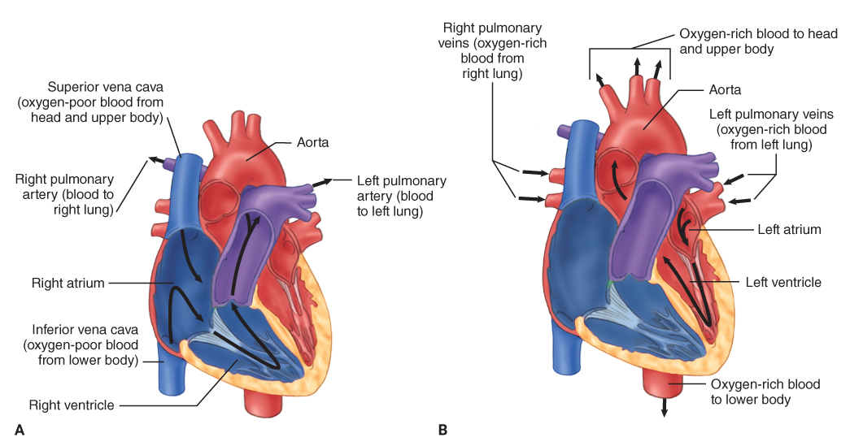
The Heart (2 of 2)
FIGURE 26-2 A. The right side of the heart circulates blood from the body to the lungs. B. The left side of the heart circulates oxygen-rich blood from the lungs to the rest of the body. It is the more muscular of the two pumps because it must pump blood into the aorta and arteries in order to reach all cells of the body.
A, B: © Jones & Bartlett Learning.
Notes:
This figure shows the right and left sides of the heart.

Slide 10
Blood Vessels and Blood (1 of 6)
Arteries
  Carry blood away from the heart
Arterioles
  Smaller vessels that connect the arteries and capillaries
Capillaries
  Pass among all the cells and link arterioles and venules
Notes:
Lecture Outline
D. Blood vessels and blood
1. Types of blood vessels:
a. Arteries
b. Arterioles
c. Capillaries

Slide 11
Blood Vessels and Blood (2 of 6)
Venules
  Very small, thin-walled vessels that empty into the veins
Veins
  Carry blood from the tissues to the heart
Notes:
Lecture Outline
d. Venules
e. Veins

Slide 12
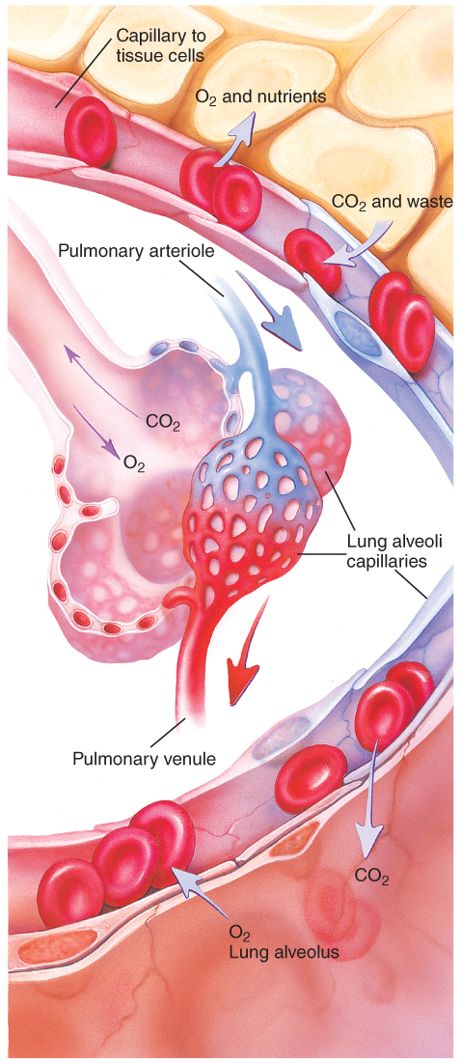
Blood Vessels and Blood (3 of 6)
Oxygen and nutrients pass from the capillaries into the cells.
Waste and carbon dioxide diffuse into the capillaries.
FIGURE 26-3 Oxygen and nutrients pass easily from the capillaries into the cells, and waste and carbon dioxide diffuse from the cells into the capillaries (top). Oxygen and carbon dioxide pass freely between the lungs and capillaries (bottom).
© Jones & Bartlett Learning.
Notes:
Lecture Outline
2. Oxygen and nutrients easily pass from the capillaries into the cells, and waste and carbon dioxide diffuse from the cells into the capillaries.

Slide 13
Blood Vessels and Blood (4 of 6)
Blood contains
  Red blood cells
    Responsible for the transportation of oxygen to the cells and carbon dioxide away from the cells to the lungs
Notes:
Lecture Outline
3. Blood contains:
a. Red blood cells

Slide 14
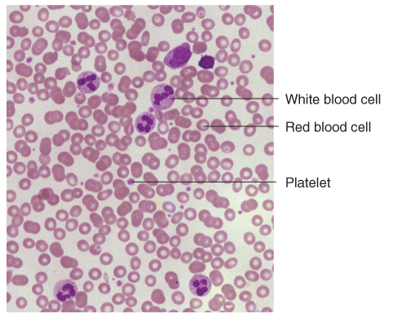
Blood Vessels and Blood (5 of 6)
Blood contains (cont’d)
  White blood cells
    Responsible for fighting infection
  Platelets
    Responsible for forming blood clots
  Plasma
FIGURE 26-4 The microscopic appearance of the three major elements in blood: red blood cells, white blood cells, and platelets.
© Donna Beer Stolz, Ph.D., Center for Biologic Imaging, University of Pittsburgh Medical School.
Notes:
Lecture Outline
White blood cells
Platelets
d. Plasma

Slide 15
Blood Vessels and Blood (6 of 6)
Blood clot formation depends on:
  Blood stasis
  Changes in the blood vessel walls
  Blood’s ability to clot
When tissues are injured, platelets begin to collect at the site of injury.
  Red blood cells to become sticky and clump together.
Notes:
Lecture Outline
4. Blood clot formation depends on several factors:
a. Blood stasis
b. Changes in the blood vessel walls (such as a wound)
c. Blood’s ability to clot (affected by disease or medication)

Slide 16
Autonomic Nervous System
Monitors the body’s needs
Adjusts blood flow
Automatically redirects blood away from other organs to the heart, brain, lungs, and kidneys in an emergency
Adapts to maintain homeostasis and perfusion
Notes:
Lecture Outline
5. Autonomic nervous system
a. Monitors the body’s needs and adjusts blood flow by constricting or dilating blood vessels
b. Automatically redirects blood away from other organs to the heart, brain, lungs, and kidneys in an emergency
c. Adapts to changing conditions in the body to maintain homeostasis and perfusion
i. If the system fails to provide sufficient circulation for every body part to perform its function, shock results.

Slide 17
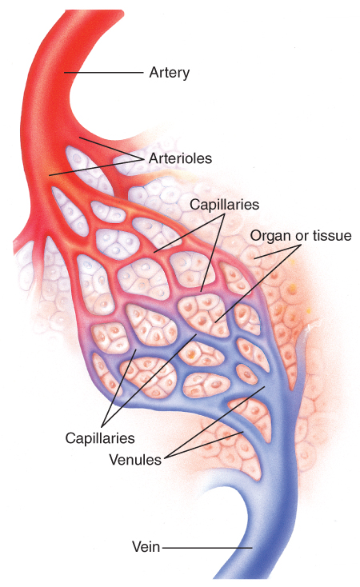
Pathophysiology and Perfusion (1 of 3)
Perfusion is the circulation of blood within an organ or tissue to meet the cells’ needs for oxygen, nutrients, and waste removal.
FIGURE 26-5 Perfusion occurs when blood circulates
through tissues or an organ to provide the necessary
oxygen and nutrients and remove waste products.
© Jones & Bartlett Learning.
Notes:
Lecture Outline
III. Pathophysiology and Perfusion
A. Perfusion is the circulation of blood within an organ or tissue in adequate amounts to meet the cells’ current needs for oxygen, nutrients, and waste removal.

Slide 18
Pathophysiology and Perfusion (2 of 3)
Speed of blood flow
  Fast enough to maintain circulation
  Slow enough to allow cells to exchange oxygen and nutrients for carbon dioxide and waste
Some tissues need a constant supply of blood, while others can survive with very little.
Notes:
Lecture Outline
1. Speed of blood flow
a. Must be fast enough to maintain adequate circulation throughout the body and to avoid clotting
b. Must be slow enough to allow cells time to exchange oxygen and nutrients for carbon dioxide and other waste products
2. Some tissues need a constant supply of blood, while others can survive with very little.

Slide 19
Pathophysiology and Perfusion (3 of 3)
All organs and organ systems depend on adequate perfusion to function properly.
  Death of an organ system can quickly lead to death of the patient.
  Emergency care supports adequate perfusion until the patient arrives at the hospital.
The heart requires a constant supply of blood.
Notes:
Lecture Outline
B. All organs and organ systems of the human body depend on adequate perfusion to function properly.
1. Some organs cannot tolerate interruption of blood supply for even a few minutes without sustaining damage.
2. Death of an organ system can quickly lead to death of the patient.
C. The heart requires a constant supply of blood.

Slide 20
External Bleeding
Hemorrhage means bleeding.
External bleeding is visible hemorrhage.
Notes:
Lecture Outline
IV. External Bleeding
A. Hemorrhage means bleeding.
1. External bleeding is visible hemorrhage.

Slide 21
Significance of External Bleeding (1 of 3)
With serious external bleeding, it may be difficult to tell the amount of blood loss.
  Blood looks different on different surfaces.
  Estimate the amount of external blood loss.
Body will not tolerate a blood loss greater than 20% of blood volume.
Notes:
Lecture Outline
B. The significance of external bleeding
1. With serious external bleeding, it may be difficult to tell the amount of blood loss.
a. Blood will look different on different surfaces
b. It is important to estimate the amount of external blood loss.
2. The body will not tolerate an acute blood loss of greater than 20% of blood volume (about 2 pints).

Slide 22
Significance of External Bleeding (2 of 3)
Changes in vital signs may occur with significant blood loss.
  Increase in heart rate
  Increase in respiratory rate
  Decrease in blood pressure
Notes:
Lecture Outline
a. Adverse changes in vital signs may occur with significant blood loss
i. Increase in heart rate
ii. Increase in respiratory rate
iii. Decrease in blood pressure

Slide 23
Significance of External Bleeding (3 of 3)
How well people compensate for blood loss is related to how rapidly they bleed.
  An adult can comfortably donate 1 unit (500 mL) of blood over 15 to 20 minutes.
  If a similar blood loss occurs in a much shorter time, the person may rapidly develop symptoms of hypovolemic shock.
  Consider age and preexisting health.
Notes:
Lecture Outline
3. How well people compensate for blood loss is related to how rapidly they bleed.
a. An adult can comfortably donate 1 unit (500 mL) of blood over a period of 15 to 20 minutes.
b. If a similar blood loss occurs in a much shorter period of time, the person may rapidly develop symptoms of hypovolemic shock.
c. The age and preexisting health of the patient should be considered.

Slide 24
Characteristics of External Bleeding (1 of 3)
Serious conditions with bleeding:
  Significant MOI
  Patient has a poor general appearance and is calm.
  Signs and symptoms of shock
  Significant blood loss
  Rapid blood loss
  Uncontrollable bleeding
Notes:
Lecture Outline
C. Characteristics of external bleeding
1. You should consider bleeding to be serious if the following conditions are present:
a. Poor general appearance and no response to external stimuli
b. Signs and symptoms of shock (hypoperfusion)
c. Significant blood loss
d. Rapid blood loss
e. Uncontrolled bleeding
f. Significant MOI

Slide 25
Characteristics of External Bleeding (2 of 3)
Arterial bleeding
  Pressure causes blood to spurt and makes bleeding difficult to control.
  Typically brighter red and spurts in time with the pulse
Venous bleeding
  Dark red, flows slowly or rapidly depending on the size of the vein
  Does not spurt and is easier to manage
Notes:
Lecture Outline
2. Arterial bleeding
a. Pressure causes blood to spurt and makes bleeding difficult to control.
b. Typically brighter red and spurts in time with the pulse
3. Venous bleeding
a. Dark red
b. Does not spurt, easier to manage, and more likely to clot spontaneously than arterial blood.
c. Can be profuse and life threatening

Slide 26
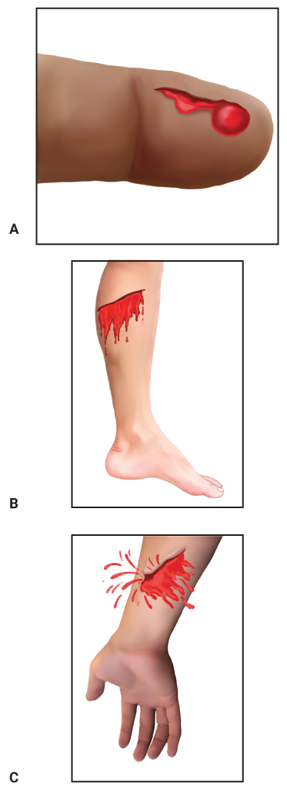
Characteristics of External Bleeding (3 of 3)
Capillary bleeding
  Bleeding from damaged capillary vessels
  Dark red, oozes steadily but slowly
FIGURE 26-7 A. Bleeding from capillary vessels is
dark red and oozes from the wound slowly but steadily.
B. Venous bleeding is darker than arterial bleeding and
flows steadily. C. Arterial bleeding is characteristically
bright red and spurts in time with the pulse.
A, B, C: © Jones & Bartlett Learning.
Notes:
Lecture Outline
4. Capillary bleeding
a. Dark red and oozes from a wound steadily but slowly
b. More likely to clot spontaneously than arterial blood

Slide 27
Clotting
Bleeding tends to stop rather quickly, within about 10 minutes.
  When skin is broken, blood flows rapidly.
  The cut end of the vessel begins to narrow, reducing the amount of bleeding.
  Then a clot forms.
  Bleeding will not stop if a clot does not form.
Notes:
Lecture Outline
5. Clotting process
a. Bleeding tends to stop rather quickly, within about 10 minutes, in response to internal mechanisms and exposure to air.
b. When the skin is broken, blood flows rapidly from the open vessel.
c. The cut ends of the vessel begin to narrow (vasoconstriction), reducing the amount of bleeding.
d. Then a clot forms.
e. Bleeding will never stop if a clot does not form, unless the injured vessel is completely cut off from the main blood supply by direct pressure or a tourniquet.

Slide 28
Hemophilia
Patient lacks blood-clotting factors.
Bleeding may occur spontaneously.
All injuries, no matter how trivial, are potentially serious.
Patients should be transported immediately.
Notes:
Lecture Outline
6. Hemophilia
a. The patient lacks one or more of the blood’s clotting factors.
b. Bleeding may occur spontaneously.
c. All injuries, no matter how trivial, are potentially serious.
d. Patients should be transported immediately.

Slide 29
Internal Bleeding (1 of 2)
Can be very serious because it is not easy to detect immediately
  Injury or damage to internal organs commonly results in extensive internal bleeding.
  Can cause hypovolemic shock
Notes:
Lecture Outline
V. Internal Bleeding
A. Can be very serious, because it is not easy to detect immediately
1. Injury or damage to internal organs commonly results in extensive internal bleeding.
2. Can cause hypovolemic shock

Slide 30
Internal Bleeding (2 of 2)
Possible conditions causing internal bleeding:
  Stomach ulcer
  Lacerated liver
  Ruptured spleen
  Broken bones
Notes:
Lecture Outline
B. Possible conditions causing internal bleeding include:
1. Stomach ulcer
2. Lacerated liver
3. Ruptured spleen
4. Broken bones

Slide 31
MOI for Internal Bleeding (1 of 2)
High-energy MOI
  Should increase your index of suspicion for serious unseen injuries
Internal bleeding is possible whenever the MOI suggests that severe forces affected the body.
  Blunt trauma
  Penetrating trauma
Notes:
Lecture Outline
C. Often, the only signs of internal bleeding are contusion or ecchymosis.
D. Mechanism of injury for internal bleeding
1. A high-energy MOI should increase your index of suspicion for the possibility of serious unseen injuries.
a. Blunt trauma
b. Penetrating trauma

Slide 32
MOI for Internal Bleeding (2 of 2)
Signs of injury (DCAP-BTLS)
  Deformities
  Contusions
  Abrasions
  Punctures/penetrations
  Burns
  Tenderness
  Lacerations
  Swelling
Notes:
Lecture Outline
2. Use mnemonic DCAP-BTLS to assess for signs of injury.
a. Deformities
b. Contusions
c. Abrasions
d. Punctures/penetrations
e. Burns
f. Tenderness
g. Lacerations
h. Swelling
i. Any other signs of injury

Slide 33
NOI for Internal Bleeding
Internal bleeding is not always caused by trauma.
Nontraumatic causes include:
  Bleeding ulcers
  Bleeding from colon
  Ruptured ectopic pregnancy
  Aneurysms
Notes:
Lecture Outline
E. Nature of illness for internal bleeding
1. Internal bleeding is not always caused by trauma
2. Possible nontraumatic causes include:
a. Bleeding ulcers
b. Bleeding from the colon
c. Ruptured ectopic pregnancy
d. Aneurysms
3. It is not as important for you to know the specific organ involved as it is to recognize that the patient is in shock and respond appropriately.

Slide 34
Signs and Symptoms of Internal Bleeding (1 of 4)
Pain (most common)
Swelling in the area of bleeding
Distention
Dyspnea, tachycardia, hypotension
Hematoma
Bruising
Notes:
Lecture Outline
F. Signs and symptoms of internal bleeding
1. Pain (most common)
2. Swelling in the area of bleeding
3. Distention
4. Bleeding into the chest cavity or lung may cause dyspnea, tachycardia, and hypotension, and hemoptysis
5. Hematoma
6. Bruising

Slide 35
Signs and Symptoms of Internal Bleeding (2 of 4)
Bleeding from any body opening
Hematemesis
Melena
Pain, tenderness, bruising, guarding, or swelling
Broken ribs
Bruises over the lower part of the chest
Rigid, distended abdomen
Notes:
Lecture Outline
7. Bleeding from any body opening
a. Bright red bleeding from the mouth or rectum
b. Hematuria
c. Nonmenstrual vaginal bleeding
8. Hematemesis—vomited blood
a. Bright red or dark red
b. Coffee-grounds appearance
9. Melena—black, foul-smelling, tarry stool with digested blood
10. Pain, tenderness, bruising, guarding, or swelling (possible closed fracture)
11. Broken ribs; bruises over the lower part of the chest; or a rigid, distended abdomen

Slide 36
Signs and Symptoms of Internal Bleeding (3 of 4)
Hypoperfusion
  Change in mental status
  Weakness, faintness, or dizziness on standing
  Changes in skin color or pallor (pale skin)
Later signs of hypoperfusion:
  Tachycardia
  Weakness, fainting, or dizziness at rest
  Thirst, nausea and vomiting
  Cold, moist (clammy) skin
Notes:
Lecture Outline
12. Hypoperfusion (hypovolemic shock)
a. Change in mental status, such as anxiety, restlessness, or combativeness
b. Weakness, faintness, or dizziness on standing
c. Changes in skin color or pallor
d. Later signs of hypoperfusion suggesting internal bleeding include:
i. Tachycardia
ii. Weakness, fainting, or dizziness at rest
iii. Thirst
iv. Nausea and vomiting
v. Cold, moist (clammy) skin
vi. Shallow, rapid breathing

Slide 37
Signs and Symptoms of Internal Bleeding (4 of 4)
Later signs of hypoperfusion (cont’d):
  Shallow, rapid breathing
  Dull eyes, slightly dilated pupils
  Capillary refill of more than 2 seconds in infants and children
  Weak, rapid (thready) pulse
  Decreasing blood pressure
  Altered level of consciousness
Notes:
Lecture Outline
vii. Dull eyes
viii. Slightly dilated pupils that are slow to respond to light
ix. Capillary refill of more than 2 seconds in infants and children
x. Weak, rapid (thready) pulse
xi. Decreasing blood pressure
xii. Altered level of consciousness
G. Patients with these signs and symptoms require prompt transport.

Slide 38
Scene Size-up (1 of 2)
Scene safety
  Be alert to potential hazards.
  In violent incidents, make sure the police are on the scene.
  Follow standard precautions.
Notes:
Lecture Outline
VI. Patient Assessment for External and Internal Bleeding
A. Scene size-up
1. Scene safety
a. Be alert to potential hazards.
b. In violent incidents, make sure the police are on the scene.
c. Follow standard precautions.

Slide 39
Scene Size-up (2 of 2)
Mechanism of injury/nature of illness
  Determine the NOI or MOI.
  Consider the need for spinal immobilization and additional resources.
  Consider environmental factors such as weather.
Notes:
Lecture Outline
2. Mechanism of injury/nature of illness
a. Consider the need for spinal immobilization and additional resources.

Slide 40
Primary Assessment (1 of 5)
Do not be distracted from identifying life threats.
Form a general impression.
  Note important indicators of the patient’s condition.
  Be aware of obvious signs of injury.
  Determine gender and age.
Notes:
Lecture Outline
B. Primary assessment
1. Do not be distracted from identifying life threats.
2. Form a general impression.
a. Note important indicators that alert you to the seriousness of the patient’s condition.

Slide 41
Primary Assessment (2 of 5)
Perform a rapid exam.
  Look for life threats and treat them as you find them.
  If the patient has obvious, life-threatening external bleeding, address it first.
  Assess skin color.
  Determine level of consciousness.
Notes:
Lecture Outline
3. Perform a rapid exam.
a. If the patient has obvious, life-threatening external bleeding, address it first.
b. Assess skin color.
c. Determine the level of consciousness using the AVPU scale.

Slide 42
Primary Assessment (3 of 5)
Airway and breathing
  Consider the need for spinal stabilization.
  Ensure a patent airway.
  Look for adequate breathing.
  Check for breath sounds.
  Provide high-flow oxygen or assist ventilations with a bag-mask device or nonrebreathing mask.
  Insert an oropharyngeal airway if the patient is unconscious.
Notes:
Lecture Outline
4. Airway and breathing
a. Ensure a patent airway.
b. Provide high-flow oxygen or assist ventilations with a bag-mask device or nonrebreathing mask.
c. Insert an oropharyngeal airway to secure the airway if the patient is unconscious.

Slide 43
Primary Assessment (4 of 5)
Circulation
  Assess pulse rate and quality.
  Determine skin condition, color, and temperature.
  Check capillary refill time.
  Control external bleeding.
  Treat for shock.
Notes:
Lecture Outline
5. Circulation
a. Assess pulse rate and quality.
b. Determine skin condition, color, and temperature.
c. Check capillary refill time.
d. Control external bleeding.
e. Treat for shock.

Slide 44
Primary Assessment (5 of 5)
Transport decision
  Assessment of XABCs and life threats will determine the transport priority.
  Signs that imply rapid transport:
    Tachycardia or tachypnea
    Low blood pressure
    Weak pulse
    Clammy skin
Notes:
Lecture Outline
6. Transport decision
a. Assessment of XABCs and life threats will determine the transport priority.
b. Patients who may have significant bleeding will quickly become unstable.
c. Signs that imply the need for rapid transport include:
i. Tachycardia
ii. Tachypnea
iii. Low blood pressure
iv. Weak pulse
v. Clammy skin

Slide 45
History Taking (1 of 2)
Investigate the chief complaint.
  Look for signs and symptoms of other injuries due to the MOI and/or NOI.
  Note obvious signs of internal bleeding.
  Assess the entire patient.
Notes:
Lecture Outline
C. History taking
1. Investigate the chief complaint.
a. Look for signs or symptoms of other injuries due to the MOI and/or NOI.

Slide 46
History Taking (2 of 2)
SAMPLE history
  Ask the patient about blood-thinning medications.
  If the patient is unresponsive, obtain history from medical alert tags or bystanders.
  Look for signs and symptoms of shock.
  Determine the amount of blood loss.
Notes:
Lecture Outline
2. SAMPLE history
a. Ask the patient about blood-thinning medications.
b. If the patient is unresponsive, obtain history information from medical alert tags or bystanders.
c. Look for signs and symptoms of shock.
d. Determine how much blood has been lost.

Slide 47
Secondary Assessment
Assess all areas for DCAP-BTLS.
Record vital signs.
Attach appropriate monitoring devices.
With a critically injured patient or a short transport time, there may not be time to conduct a secondary assessment.
Notes:
Lecture Outline
Secondary assessment
1. Assess all areas for DCAP-BTLS.
a. Head—Look for uncontrolled bleeding from large scalp lacerations.
b. Abdomen—Feel all four quadrants for tenderness or rigidity.
c. Extremities—Record pulse, motor, and sensory function.
2. Record vital signs.
3. With a critically injured patient or a short transport time, there may not be time to conduct a secondary assessment.

Slide 48
Reassessment (1 of 3)
Reassess the patient in areas that showed abnormal findings.
  Signs and symptoms of internal bleeding are often slow to present.
Reassess an unstable patient every 5 minutes and a stable patient every 15 minutes.
Notes:
Lecture Outline
E. Reassessment
1. Reassess the patient frequently, especially in the areas that showed abnormal findings during the primary assessment.
2. Reassess an unstable patient every 5 minutes and a stable patient every 15 minutes.

Slide 49
Reassessment (2 of 3)
Interventions
  Provide high-flow oxygen.
  Control external bleeding.
  Provide treatment for shock and transport rapidly.
  Do not delay transport of a patient to complete an assessment.
Notes:
Lecture Outline
3. Interventions
a. Provide high-flow oxygen.
b. Control external bleeding.
c. Provide treatment for shock (if applicable) and transport rapidly.
d. If internal bleeding is suspected, apply high-flow oxygen via a nonrebreathing mask and provide rapid transport.
e. Do not delay transport of a patient to complete an assessment.

Slide 50
Reassessment (3 of 3)
Communication and documentation
  Recognize, estimate, and report the amount of blood loss and how rapidly or over what period of time it occurred.
  Communicate all relevant information to the staff at the receiving hospital.
  Document all injuries, the care provided, and the patient’s response.
Notes:
Lecture Outline
4. Communication and documentation
a. Recognize, estimate, and report the amount of blood loss and how rapidly or over what period of time it occurred.
b. Communicate all relevant information to the staff at the receiving hospital, including all injuries, the care provided, and the patient’s response

Slide 51
Emergency Medical Care for External Bleeding (1 of 2)
Follow standard precautions.
  Wear gloves, eye protection, and possibly a mask or gown.
  Make sure the patient has an open airway and is breathing adequately.
  Provide high-flow oxygen.
  Control obvious, life-threatening bleeding as quickly as possible.
Notes:
Lecture Outline
VII. Emergency Medical Care for External Bleeding
A. Follow standard precautions.
1. Wear gloves, eye protection, and possibly a mask or gown.
2. Make sure that the patient has an open airway and is breathing adequately.
3. Provide high-flow oxygen.
4. If obvious, life-threatening bleeding is present, control it as quickly as possible.

Slide 52
Emergency Medical Care for External Bleeding (2 of 2)
Several methods are available to control external bleeding.
  Direct, even pressure and elevation
  Pressure dressings and/or splints
  Tourniquets
  Hemostatic dressing
  Wound packing
Notes:
Lecture Outline
B. Several methods are available to control external bleeding.
1. Direct, even pressure
2. Pressure dressings and/or splints
3. Tourniquets
4. Hemostatic dressing
5. Wound packing

Slide 53
Direct Pressure
Most common and effective way to control external bleeding
Pressure stops the flow of blood and permits normal coagulation to occur.
Apply pressure with your gloved fingertip or hand over the top of a sterile dressing.
Hold uninterrupted pressure for at least 5 minutes.
Notes:
Lecture Outline
C. Direct pressure
1. Most common and effective way to control external bleeding
2. Pressure stops the flow of blood and permits normal coagulation to occur.
3. Apply pressure with your gloved fingertip or hand over the top of a sterile dressing.
4. For an object protruding from the wound, apply bulky dressings to stabilize the object in place, and apply pressure as best you can.
5. Hold uninterrupted pressure for at least 5 minutes.

Slide 54
Pressure Dressing
Firmly wrap a sterile, self-adhering roller bandage around the entire wound.
Stretch the band tight enough to control bleeding.
Do not remove a dressing until a physician has evaluated the patient.
A tourniquet is useful if the bleeding cannot be managed with direct pressure.
Notes:
Lecture Outline
D. Pressure dressing
1. Firmly wrap a sterile, self-adhering roller bandage around the entire wound.
2. Stretch the bandage tight enough to control bleeding.
a. You should still be able to palpate a distal pulse on the injured extremity after applying the dressing.
3. Do not remove a dressing until a physician has evaluated the patient.
a. Apply additional manual pressure through the dressing.
b. If necessary, add more dressings over the first.
4. The tourniquet is useful if a patient has substantial bleeding from an extremity injury that cannot be controlled with direct pressure.
a. Apply the tourniquet above the level of bleeding
b. If this is not possible, consider a junctional tourniquet or wound packing with a hemostatic dressing if available.
5. Follow Skill Drill 26-1 to demonstrate the basic techniques to control external bleeding.

Slide 55
Hemostatic Agents
Gauze can be packed into larger wounds when direct pressure is inadequate, or application of a tourniquet is not possible.
A hemostatic dressing is impregnated with a chemical compound that slows or stops bleeding by promoting clot formation.
Notes:
Lecture Outline
E. Wound packing and hemostatic dressings
1. Gauze can be packed into larger wounds to control hemorrhage when direct pressure is not adequate, or application of a tourniquet is not possible.
2. A hemostatic dressing is impregnated with a chemical compound that slows or stops bleeding by promoting clot formation.
a. Can be used together with wound packing and direct pressure when direct pressure alone is ineffective or when tourniquet placement is otherwise impossible.
3. Follow Skill Drill 26-2 to demonstrate the basic techniques for packing a wound.

Slide 56
Tourniquets (1 of 2)
Useful if a patient has substantial bleeding from an extremity injury
Several types of commercial tourniquets are available.
Notes:
Lecture Outline
F. Tourniquets
1. If direct pressure does not control extremity bleeding, then use a tourniquet.
a. A tourniquet is only useful if a patient has substantial bleeding from an extremity injury
2. Follow the steps in Skill Drill 26-3 to demonstrate applying commercial tourniquet.

Slide 57
Tourniquets (2 of 2)
Junctional tourniquets allow for compression of life-threatening bleeding in areas where standard tourniquet application is not possible.
May be indicated for severe hemorrhage at the junction of the torso with the arms and legs.
Notes:
Lecture Outline
G. Junctional tourniquets
1. Allow for proximal compression of life-threatening bleeding in areas where standard tourniquet application is not possible, such as the groin or axilla.
2. May be indicated for severe hemorrhage at the junction of the torso with the arms or legs.
3. Some junctional tourniquets may be used as a pelvic binder.

Slide 58
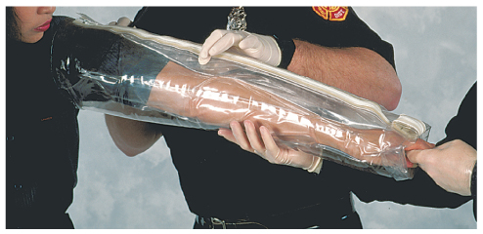
Splints (1 of 3)
Air splints
  Soft splints or pressure splints
  Can control internal or external bleeding associated with severe injuries
FIGURE 26-11 Air splints can also be used to control
bleeding because they act as a pressure bandage for the
entire extremity. They are not as effective as tourniquets,
however, and should never be used when a tourniquet is
otherwise indicated.
© Jones & Bartlett Learning. Courtesy of MIEMSS.
Notes:
Lecture Outline
Splints
1. Air splints
a. Can control internal or external bleeding associated with severe extremity injuries
b. Immobilize fractures
c. Act like a pressure dressing applied to an entire extremity rather than to a small, local area

Slide 59
Splints (2 of 3)
Air splints (cont’d)
  Immobilize fractures
  Act like a pressure dressing
  Use only approved, clean, or disposable valve stems.
Notes:
Lecture Outline
1. Air splints
a. Can control internal or external bleeding associated with severe extremity injuries
b. Immobilize fractures
c. Act like a pressure dressing applied to an entire extremity rather than to a small, local area

Slide 60
Splints (3 of 3)
Pelvic binder
  A type of splint that may be indicated for a suspected closed unstable pelvic fracture
  Helps to control internal bleeding
Notes:
Lecture Outline
I. Pelvic binder
1. A type of splint that may be indicated for a suspected closed unstable pelvic fracture
a. Helps to control internal bleeding, specifically bleeding associated with a life-threatening open-book pelvic fracture

Slide 61
Bleeding From the Nose, Ears, and Mouth (1 of 4)
Several conditions
  Skull fracture
  Facial injuries
  Sinusitis, infections, use and abuse of nose drops, dried or cracked nasal mucosa
  High blood pressure
  Coagulation disorders
  Digital trauma
  Cancer
Notes:
Lecture Outline
G. Bleeding from the nose, ears, and mouth
1. Several conditions can result in bleeding from the nose, ears, and/or mouth, including the following:
a. Skull fracture
b. Facial injuries
c. Sinusitis, infections, use and abuse of nose drops, dried or cracked nasal mucosa, or other abnormalities
d. High blood pressure
e. Coagulation disorders
f. Digital trauma
g. Cancer

Slide 62
Bleeding From the Nose, Ears, and Mouth (2 of 4)
Epistaxis (nosebleed) is a common emergency.
  Occasionally it can cause enough blood loss to send a patient into shock.
  Can usually be controlled by pinching the nostrils together
Notes:
Lecture Outline
2. Epistaxis (nosebleed)
a. Common emergency
b. Occasionally can cause enough blood loss to lead to shock
c. The blood you see may be only a small part of the total blood loss.
i. Much of the blood may pass down the throat into the stomach as the patient swallows.
ii. A person who swallows a large amount of blood may become nauseated and start vomiting (may be confused with internal bleeding).
d. Most nontraumatic nosebleeds occur from sites in the septum, the tissue dividing the nostrils.
e. You can usually handle this type of bleeding effectively by pinching the nostrils together.
f. Follow the steps in Skill Drill 26-4 to control epistaxis.

Slide 63
Bleeding From the Nose, Ears, and Mouth (3 of 4)
Bleeding from the nose or ears following a head injury:
  May indicate a skull fracture
  May be difficult to control
  Do not attempt to stop blood flow.
  Loosely cover the bleeding site with a sterile gauze pad.
  Apply light compression with a dressing.
Notes:
Lecture Outline
3. Bleeding from the nose or ears following a head injury
a. May indicate a skull fracture
b. May be difficult to control
c. Do not attempt to stop blood flow.
i. Applying excessive pressure to the injury may force the blood leaking through the ear or nose to collect within the head.
ii. Loosely cover the bleeding site with a sterile gauze pad to collect the blood and help keep contaminants away from the site.
iii. Apply light compression by wrapping the dressing loosely around the head.

Slide 64
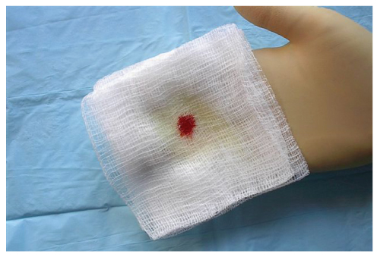
Bleeding From the Nose, Ears, and Mouth (4 of 4)
A target or halo-shaped stain may occur on the dressing if blood or drainage contains cerebrospinal fluid.
FIGURE 26-14 When cerebrospinal fluid is present in blood or drainage, a stain in the shape of a target or halo will appear.
Courtesy of Rhonda Hunt.
Notes:
Lecture Outline
d. A target or halo-shaped stain may occur on the dressing if blood or drainage contains cerebrospinal fluid.

Slide 65
Emergency Medical Care for Internal Bleeding
Usually requires surgery or other hospital procedures
Keep the patient calm, reassured, and as still and quiet as possible.
Provide high-flow oxygen.
Maintain body temperature.
Splint the injured extremity (air splint).
Notes:
Lecture Outline
VIII. Emergency Medical Care for Internal Bleeding
A. Controlling internal bleeding or bleeding from major organs usually requires surgery or other hospital procedures.
1. Keep the patient calm, reassured, and as still and quiet as possible.
2. Provide high-flow oxygen.
3. Maintain body temperature.
4. Splint the injured extremity (usually with an air splint).
5. Never use a tourniquet to control the bleeding from closed, internal, and/or soft-tissue injuries.
6. Follow the steps in Skill Drill 26-5 to care for patients with internal bleeding.

Slide 66
Review
Which of the following is NOT a component of the cardiovascular system?
  Heart
  Lungs
  Venules
  Plasma

Slide 67
Review
Answer: B
Rationale: Components of the cardiovascular system include the heart, blood vessels (arteries, arterioles, capillaries, venules, and veins), and blood (plasma and blood cells). The lungs are a component of the respiratory system.

Slide 68
Review
Which of the following is NOT a component of the cardiovascular system?
  Heart
  Rationale: This is part of the cardiovascular system.
  Lungs
  Rationale: Correct answer
  Venules
  Rationale: This is part of the cardiovascular system.
  Plasma
  Rationale: This is part of the cardiovascular system.

Slide 69
Review
Perfusion is MOST accurately defined as:
  the removal of adequate amounts of carbon dioxide during exhalation.
  the intake of adequate amounts of oxygen during the inhalation phase.
  circulation of blood within an organ with sufficient amounts of oxygen.
  the production of carbon dioxide, which accumulates at the cellular level.

Slide 70
Review
Answer: C
Rationale: Perfusion is the circulation of blood within an organ and tissues with sufficient amounts of oxygen and other nutrients. Carbon dioxide is the by-product of normal cellular metabolism; it should be returned to the lungs for removal from the body; it should not accumulate at the cellular level.

Slide 71
Review
Perfusion is MOST accurately defined as:
  the removal of adequate amounts of carbon dioxide during exhalation.
  Rationale: Removal of carbon dioxide is a part of exhalation, and not perfusion.
  the intake of adequate amounts of oxygen during the inhalation phase.
  Rationale: This is a function of ventilation, and not perfusion.
  circulation of blood within an organ with sufficient amounts of oxygen.
  Rationale: Correct answer
  the production of carbon dioxide, which accumulates at the cellular level.
  Rationale: Carbon dioxide is a normal by-product of cellular metabolism and should not accumulate in the cells.

Slide 72
Review
A man involved in a motorcycle crash has multiple abrasions and lacerations. Which of the following injuries has the HIGHEST treatment priority?
  Widespread abrasions to the back with pinkish ooze
  3-inch laceration to the forehead with dark red, flowing blood
  Laceration to the forearm with obvious debris in the wound
  1-inch laceration to the thigh with spurting, bright red blood

Slide 73
Review
Answer: D
Rationale: Bleeding from an artery produces bright red bleeding that spurts with the pulse. The pressure that causes the blood to spurt also makes this type of bleeding difficult to control. Blood loss from an arterial wound is more severe—and thus, more life threatening—than from a venous wound.

Slide 74
Review
A man involved in a motorcycle crash has multiple abrasions and lacerations. Which of the following injuries has the HIGHEST treatment priority?
  Widespread abrasions to the back with pinkish ooze
  Rationale: Abrasions are painful, but not an immediate life threat.
  3-inch laceration to the forehead with dark red, flowing blood
  Rationale: Venous bleeding is controlled after arterial bleeding is controlled.
  Laceration to the forearm with obvious debris in the wound
  Rationale: There is no indication that this wound is actively bleeding.
  1-inch laceration to the thigh with spurting, bright red blood
  Rationale: Correct answer

Slide 75
Review
Which of the following sets of vital signs is LEAST indicative of internal bleeding?
  BP, 140/90 mm Hg; pulse rate, 58 beats/min; respirations, 8 breaths/min
  BP, 100/50 mm Hg; pulse rate, 120 beats/min; respirations, 24 breaths/min
  BP, 98/60 mm Hg; pulse rate, 110 beats/min; respirations, 28 breaths/min
  BP, 102/48 mm Hg; pulse rate, 100 beats/min; respirations, 22 breaths/min

Slide 76
Review
Answer: A
Rationale: Internal hemorrhage typically reveals vital signs that are consistent with shock: hypotension, tachycardia, and tachypnea. Hypertension, bradycardia, and bradypnea (choice “A”) is consistent with a closed head injury, not internal bleeding.

Slide 77
Review
Which of the following sets of vital signs is LEAST indicative of internal bleeding?
  BP, 140/90 mm Hg; pulse rate, 58 beats/min; respirations, 8 breaths/min
  Rationale: Correct answer
  BP, 100/50 mm Hg; pulse rate, 120 beats/min; respirations, 24 breaths/min
  Rationale: This is indicative of a progression to decompensated shock.
  BP, 98/60 mm Hg; pulse rate, 110 beats/min; respirations, 28 breaths/min
  Rationale: This is indicative of a progression to decompensated shock.
  BP, 102/48 mm Hg; pulse rate, 100 beats/min; respirations, 22 breaths/min
  Rationale: This is indicative of a progression to decompensated shock.

Slide 78
Review
When caring for a patient with internal bleeding, the EMT must first:
  ensure a patent airway.
  obtain baseline vital signs.
  control any external bleeding.
  take appropriate standard precautions.

Slide 79
Review
Answer: D
Rationale: All of the interventions in this question must be performed. However, before providing patient care—whether the patient is bleeding or not—the EMT must first ensure that he or she has taken the appropriate standard precautions.

Slide 80
Review
When caring for a patient with internal bleeding, the EMT must first:
  ensure a patent airway.
  Rationale: This would be the first step after standard precautions.
  obtain baseline vital signs.
  Rationale: This would be the third step after standard precautions, airway, and bleeding control.
  control any external bleeding.
  Rationale: This would be the second step after standard precautions and airway.
  take appropriate standard precautions.
  Rationale: Correct answer

Slide 81
Review
The quickest and MOST effective way to control external bleeding from an extremity is:
  a pressure bandage.
  direct pressure and elevation.
  a splint.
  a tourniquet.

Slide 82
Review
Answer: B
Rationale: Direct pressure is the quickest, most effective way to control external bleeding from an extremity. This will effectively control external bleeding in most cases.

Slide 83
Review
The quickest and MOST effective way to control external bleeding from an extremity is:
  a pressure bandage.
  Rationale: This is done after direct pressure has controlled the bleeding.
  direct pressure and elevation.
  Rationale: Correct answer
  a splint.
  Rationale: Most cases of external bleeding can be controlled by direct pressure and elevation and do not require a splint.
  a tourniquet.
  Rationale: This is the last method of controlling external bleeding.

Slide 84
Review
When applying a tourniquet to an amputated arm, the EMT should:
  use the narrowest bandage possible.
  avoid applying the tourniquet over a joint.
  cover the tourniquet with a sterile bandage.
  use rope to ensure that the tourniquet is tight.

Slide 85
Review
Answer: B
Rationale: If you must apply a tourniquet, never apply it directly over a joint. You should use the widest bandage possible and make sure it is secured tightly. Never use wire, rope, a belt, or any other narrow material, as it could cut the skin. The tourniquet should never be covered with a bandage. Leave it open and in full view.

Slide 86
Review
When applying a tourniquet to an amputated arm, the EMT should:
  use the narrowest bandage possible.
  Rationale: You should use the widest bandage possible.
  avoid applying the tourniquet over a joint.
  Rationale: Correct answer
  cover the tourniquet with a sterile bandage.
  Rationale: You should leave a tourniquet open and in plain view.
  use rope to ensure that the tourniquet is tight.
  Rationale: Never use a wire, rope, belt, or any other narrow material, as it may cut or damage the extremity.

Slide 87
Review
A 70-year-old man is experiencing a severe nosebleed. When you arrive, you find him leaning over a basin, which contains an impressive amount of blood. He has a history of coronary artery disease, diabetes, and migraine headaches. His BP is 180/100 and his heart rate is 100 beats/min. Which of the following is the MOST likely contributing factor to his nosebleed?
  His blood pressure
  His history of diabetes
  The fact that he is elderly
  His heart rate of 100 beats/min

Slide 88
Review
Answer: A
Rationale: Several conditions can cause a nosebleed (epistaxis), including skull fractures, facial injuries, sinusitis (inflamed sinuses), high blood pressure, coagulation disorders (ie, hemophilia), and digital trauma (ie, nose picking). A BP of 180/100 indicates a significant amount of pressure on the arteries, which is no doubt the main contributing factor to this patient’s nosebleed.

Slide 89
Review (1 of 2)
A 70-year-old man is experiencing a severe nosebleed. When you arrive, you find him leaning over a basin, which contains an impressive amount of blood. He has a history of coronary artery disease, diabetes, and migraine headaches. His BP is 180/100 and his heart rate is 100 beats/min. Which of the following is the MOST likely contributing factor to his nosebleed?
  His blood pressure
  Rationale: Correct answer
  His history of diabetes
  Rationale: Diabetes can be a cause of hypertension and vascular problems, but typically is not a condition that will cause epistaxis.

Slide 90
Review (2 of 2)
A 70-year-old man is experiencing a severe nosebleed. When you arrive, you find him leaning over a basin, which contains an impressive amount of blood. He has a history of coronary artery disease, diabetes, and migraine headaches. His BP is 180/100 and his heart rate is 100 beats/min. Which of the following is the MOST likely contributing factor to his nosebleed?
  The fact that he is elderly
  Rationale: Elderly patients are prone to hypertension, which can cause epistaxis, but age is not a factor.
  His heart rate of 100 beats/min
  Rationale: His heart rate may be a result of his age or a compensatory mechanism dealing with blood loss.

Slide 91
Review
When caring for a patient with severe epistaxis, the MOST effective way to prevent aspiration of blood is to:
  insert a nasopharyngeal airway and lean the patient back.
  tilt the patient’s head forward while he or she is leaning forward.
  place the patient supine with his or her head in the flexed position.
  tilt the patient’s head forward while he or she is leaning backward.

Slide 92
Review
Answer: B
Rationale: Leaning forward, with the head tilted forward, will stop blood from trickling down the throat. This decreases the risk that the patient will swallow the blood, which may cause vomiting, or aspirating the blood into the lungs.

Slide 93
Review
When caring for a patient with severe epistaxis, the MOST effective way to prevent aspiration of blood is to:
  insert a nasopharyngeal airway and lean the patient back.
  Rationale: Never insert a nasopharyngeal airway into actively bleeding nares.
  tilt the patient’s head forward while he or she is leaning forward.
  Rationale: Correct answer
  place the patient supine with his or her head in the flexed position.
  Rationale: Lying a patient supine with epistaxis will cause blood to be swallowed and may cause vomiting.
  tilt the patient’s head forward while he or she is leaning backward.
  Rationale: Tilt the patient’s head forward, but the patient’s body must also lean forward.

Slide 94
Review
Controlling internal bleeding requires:
  applying a tourniquet.
  surgery in a hospital.
  positioning the patient in the sitting position.
  providing slow and considerate transport.

Slide 95
Review
Answer: B
Rationale: Controlling internal bleeding usually requires surgery that must be done in the hospital. To care for the patient in the field, administer high-flow oxygen and assist ventilations, if needed; control all obvious external bleeding; monitor and record the vital signs every 5 minutes; place the nontrauma patient in a shock position; keep the patient warm; and provide immediate transport.

Slide 96
Review
Controlling internal bleeding requires:
  applying a tourniquet.
  Rationale: Never use a tourniquet to control bleeding from closed, internal, soft-tissue injuries.
  surgery in a hospital.
  Rationale: Correct answer
  positioning the patient in the sitting position.
  Rationale: You should place the patient in a supine position.
  providing slow and considerate transport.
  Rationale: You should provide immediate transport.

